Slide 1
Industry Mapping
Generating map of industries from companies large network
Snir Lugassy, Alon Shiri

Slide 2
What is an industry map?
Weighted directed graph (Network)

Slide 3
Motivation
Visual insight about relations in a large corpus
Recommendation Systems
Distance / Similarity measures between industries based on graph theory

Slide 4
Pipeline Overview
Text filtering and normalization
Word embedding
Fast 1-NN using XXX
Map Reduce
Relation thresholds
Drawing

Slide 5
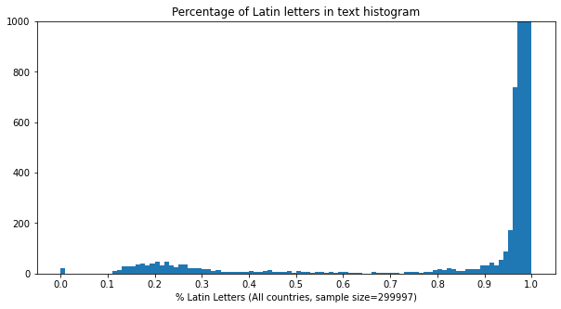
Text filtering
- Keeping only companies from USA
- Companies text that contains more than 90% latin letters
Number of rows after filtering: 1,216,967

Slide 6
Text normalization
- Remove HTML tags
- Remove special characters
- Remove digits
- Remove redundant whitespace
- Remove terms with less than 3 characters or more than 15 characters
- Remove stopwords
- Convert to lowercase

Slide 7
Word embedding (vectorizing)
Using tf-idf
Removing terms that appear in more than 70% of the documents
Vector space dimension: 6,047,551 (very noisy)

Slide 8
Adding the “related to” column
For each company we want to find the most similar company in the data
“related to” will hold the ID of the similar company
Finding the similar company is actually is an NNS (Nearest Neighbor Search) problem, in our case 1-NN
This relation will result in a network in which the nodes are companies and the edges are the relation between to companies

Slide 9
Naive 1-NN - Linear search
- Exhaustively search for the nearest neighbor of each vector
- Complexity: $O(n^{2})$
- 1-NN for for matrix with shape (1,216,967, 6,047,551) will require:
$\left({1.21⋅{10}^{6} \atop 2}\right)≈7.32⋅{10}^{11}$ vectors operations
- Efficiently, cosine similarity in this space takes around 10 ms
- Theoretically, should take around 5,571 years $(\frac{n(n-1)}{2}⋅\frac{10}{1000⋅60⋅60⋅365}≈5571)$

Slide 10
Improved Nearest Neighbors search
Methods to reject candidates, for example using space partitions
For example, using k-d tree: partitions the space using a binary tree
Bad performance on high dimensional data (“Curse of dimensionality”)
=> Lack of support for sparse vectors (converting to dense in not feasible)

Slide 11
ANN for the rescue
Approximate Nearest Neighbors
Instead of finding the exact K Nearest Neighbors, find K neighbors which are close enough (works for many practical applications) to the query
The distance between the query and the approximate NN is bounded by:
$$c⋅min_{x}D(q,x)$$

Slide 12
ANN using pysparnn
Approximate Nearest Neighbors
We used pysparnn, developed by Facebook research
Using tree structure to quickly find $\sqrt{N}$ candidates using sparse vectors
Took around 37 ms to find 1-NN for one company
Found all 1-NN in around 11 hours (over 1.21 million queries) on a single CPU without distributed computations
github.com/facebookresearch/pysparnn

Slide 13
Constructing the Industry Map
We will construct the final industry map (network) by reducing the companies network
Given the companies network $G(V,E)$, we will construct a weighted directed graph as follows:
$$V^{′}=\{1,2,3,..,M\}$$
$E^{′}=V^{′}×V^{′}$
$$w(i,j)=|\{(x,y)∈E:I(x)=i,I(y)=j\}|$$
$I(c)$ is the industry of company $c$

Slide 14
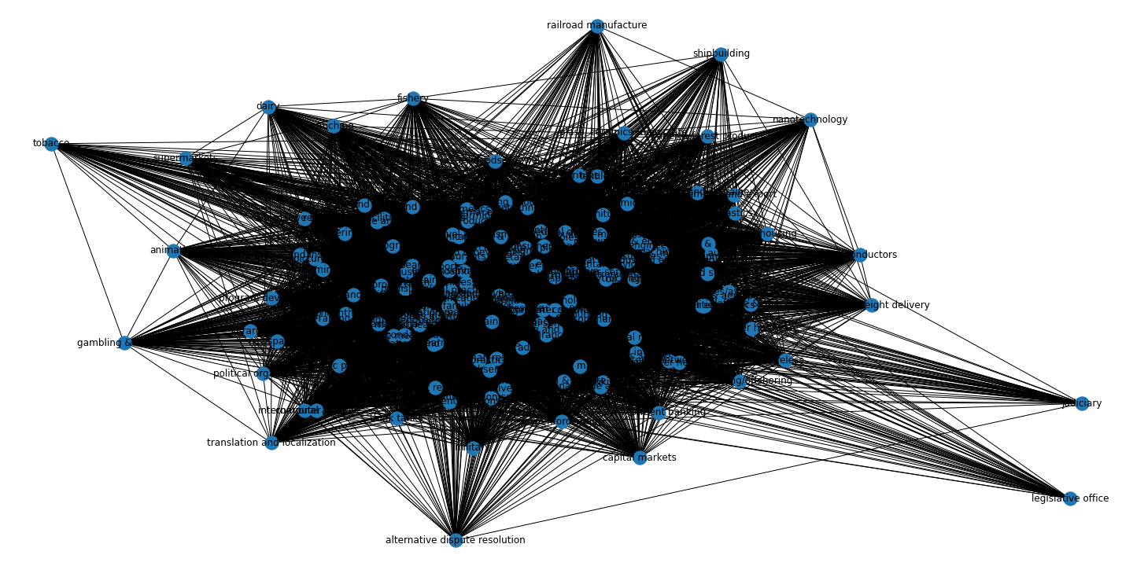
Raw Industry Map

Slide 15
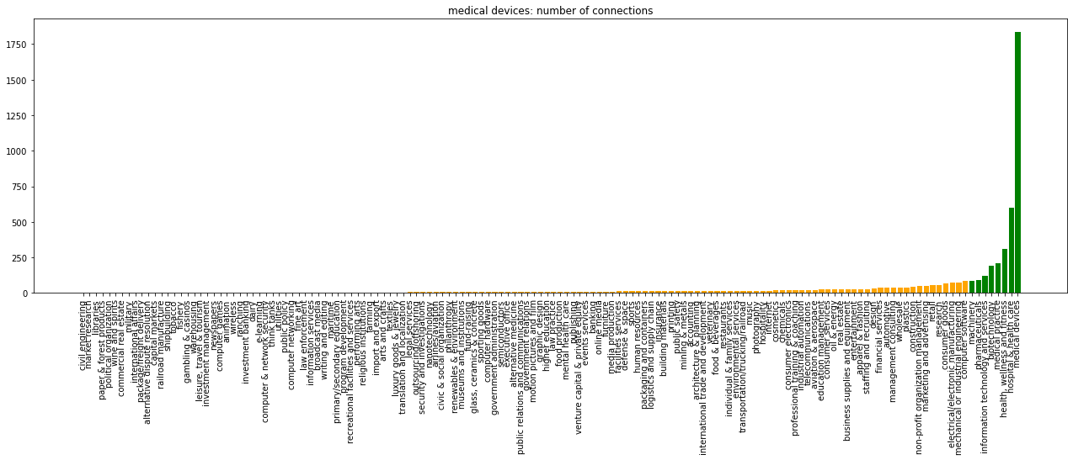
Local weights histogram
Medical Devices - Edges weight histogram
Important Relations
Less Important Relations

Slide 16
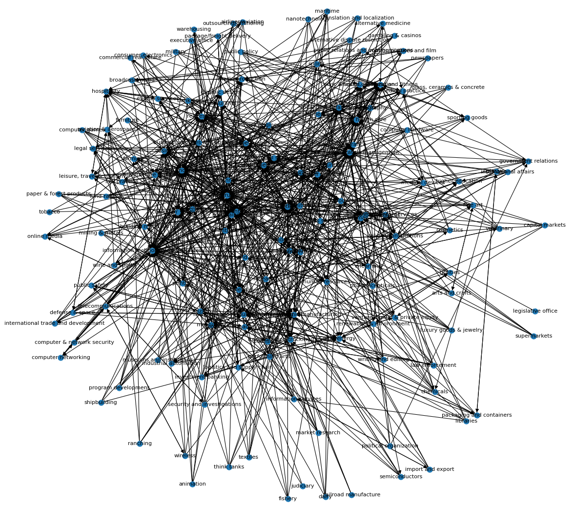
Filtered Industry Map
- For each node we retained only the top 5% of edges according to their weight
- Keeping only the important relations, results in a cleaner graph
- Spring Layout

Slide 17
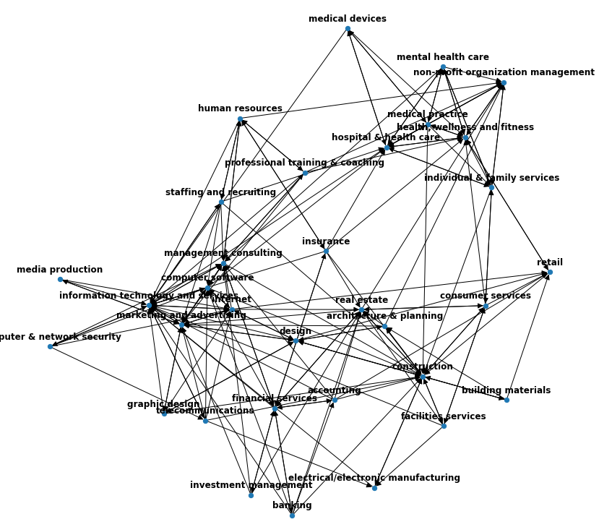
Computer Software Neighborhood
Subgraph of “Computer Software” and it’s second degree neighbors

Slide 18
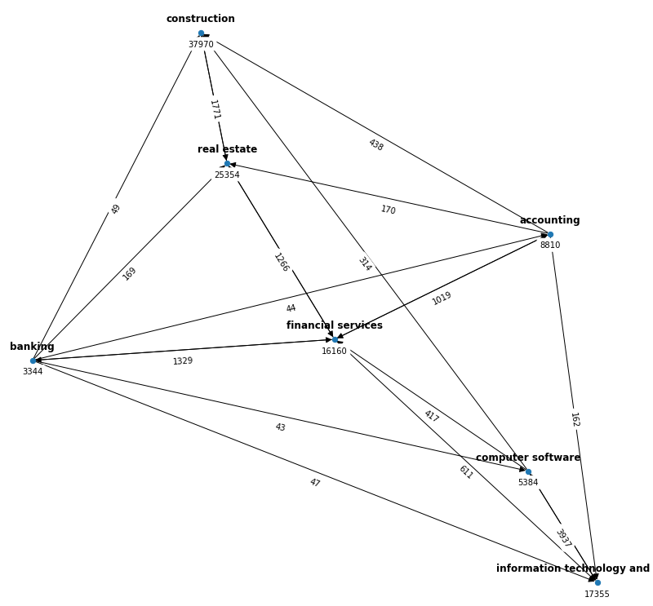
Banking Neighborhood
Subgraph of “Banking” and it’s neighbors

Slide 19
Summary
The industry map settles with our knowledge about industry relations
More informative than usual clustering (measurable distance using weighted shortest-path)
This pipeline can be easily applied on datasets from other domains (e.g., Product description and category)
“We connect people who make community for a better world of changes”
~ Nadir Hackerman, WEBOS

